Slide 1

Ch.15 Presenting data
2021-03-11
서보경

Slide 2
목차
Understanding Input and Output
Redirecting Output & Input in Scripts
Creating Your Own Redirection
Listing Open File Descriptors
Suppressing Command Output
Using Temporary Files
Logging Messages

Slide 3
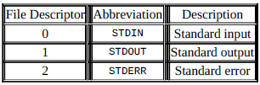
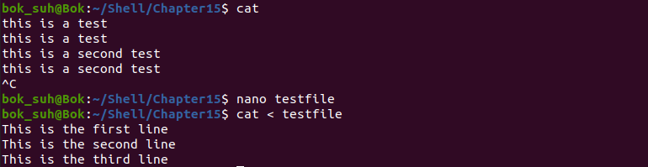

1. Understanding Input and Output
File descriptor : 음이 아닌 정수, 최대 9개
STDIN: standard input
STDOUT: standard output
STDERR: standard error output

Slide 4

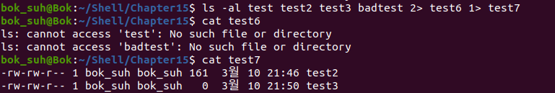
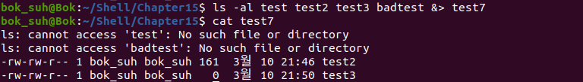
1. Understanding Input and Output
Redirecting Errors only
Redirection symbol 바로 앞에 file descriptor value
&> : STDERR + STDOUT

Slide 5
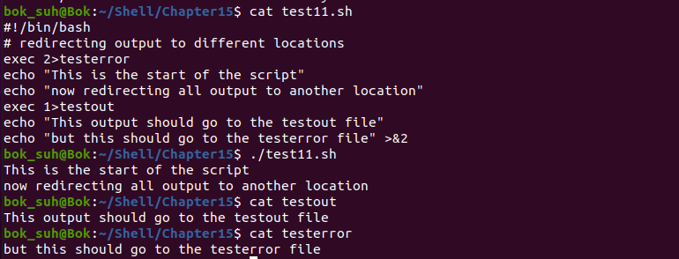
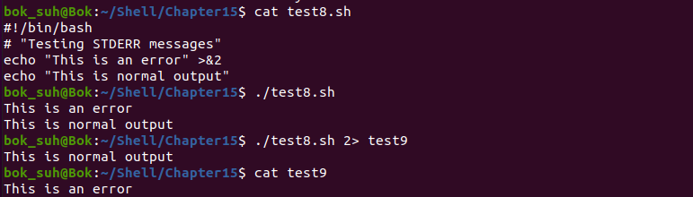
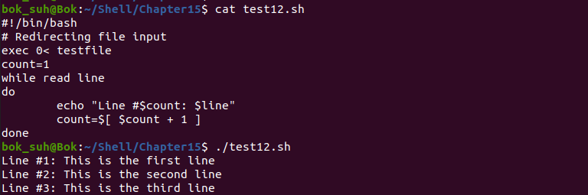
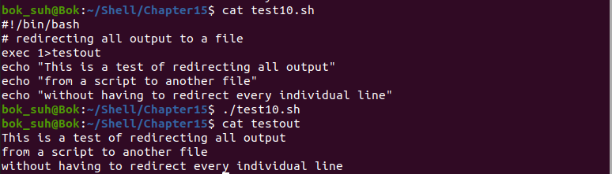
2. Redirecting Input & Output in Scripts
Redirect할 때 file descriptor 앞에 “&”
‘exec’ command로 계속 redirect

Slide 6
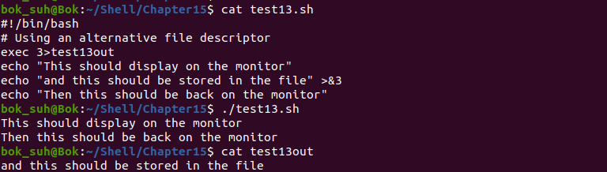
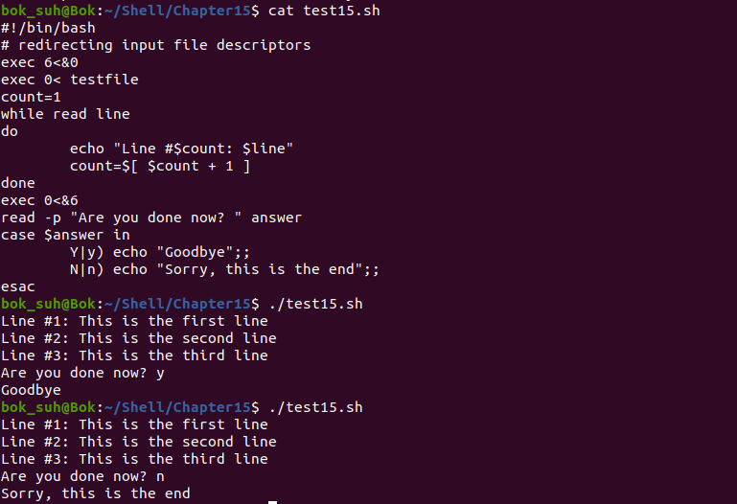
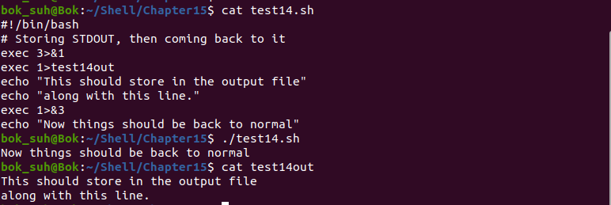
3. Creating Your Own Redirection

Slide 7
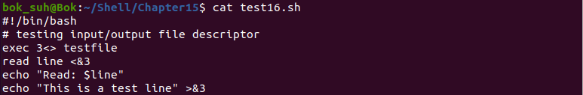
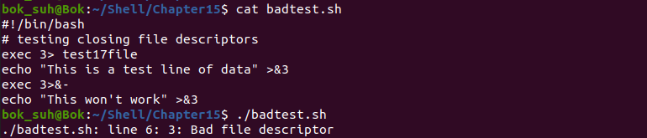
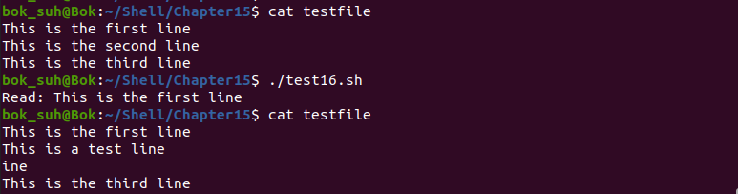
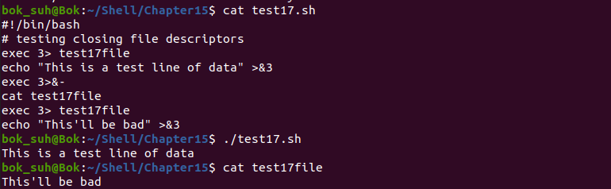
3. Creating Your Own Redirection

Slide 8

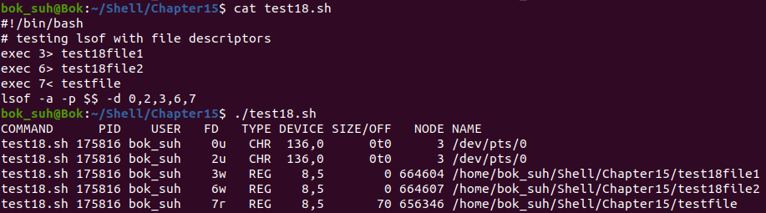
4. Listing Open File Descriptors
‘lsof’ package

Slide 9
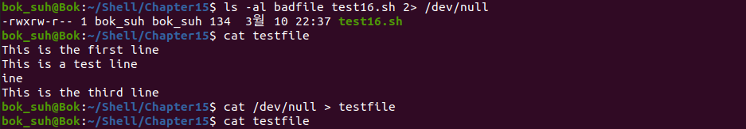
5. Suppressing Command Output
Null file → /dev/null

Slide 10
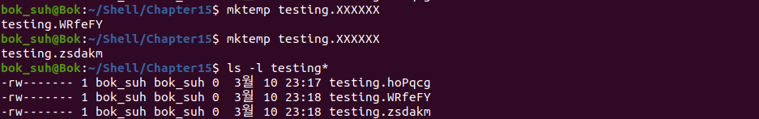
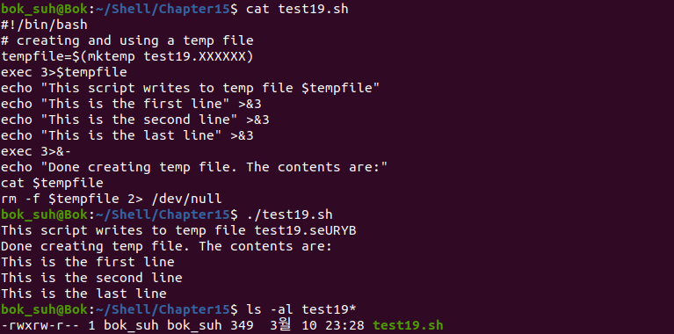
6. Using Temporary Files
mktemp

Slide 11
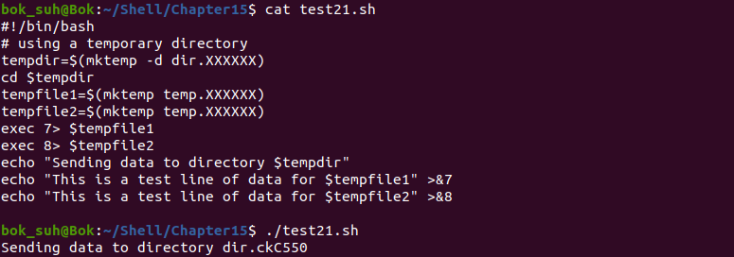
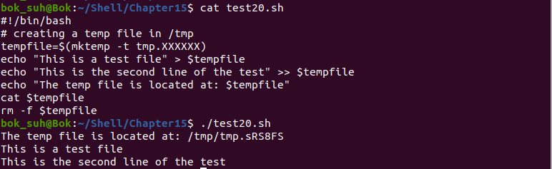
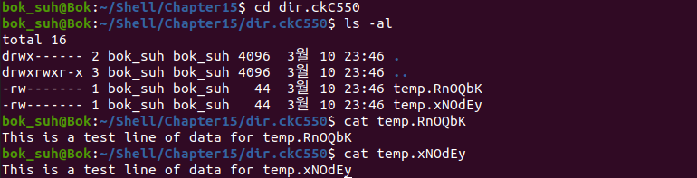
6. Using Temporary Files

Slide 12
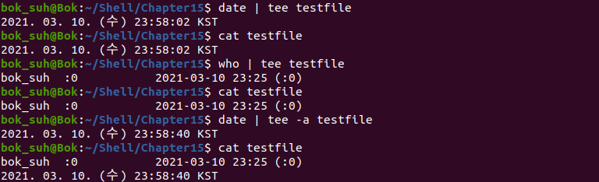
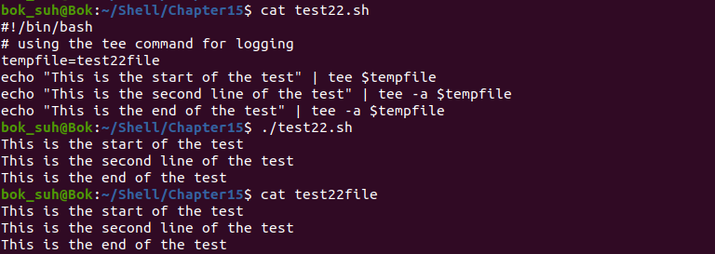
7. Logging Messages
tee

Slide 13
감사합니다.

